Slide 1




PORTFOLIO MANAGEMENT SYSTEM
BY
LAKSHMI NARAYANAN D
ABIRAMI J

Slide 2

The Portfolio Management System (PMS) is a financial application built using React, FastAPI, and PostgreSQL to manage portfolios, securities, asset allocation, and historical market data.It provides benchmark comparison, portfolio performance tracking, and asset-class and security-level rebalancing through trades and alerts.

Slide 3
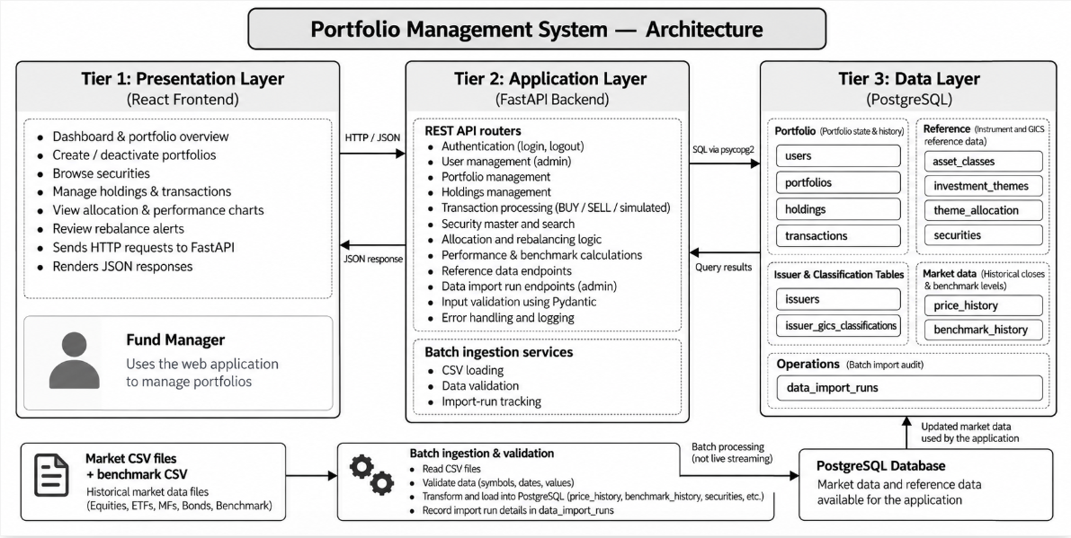
02

Slide 4
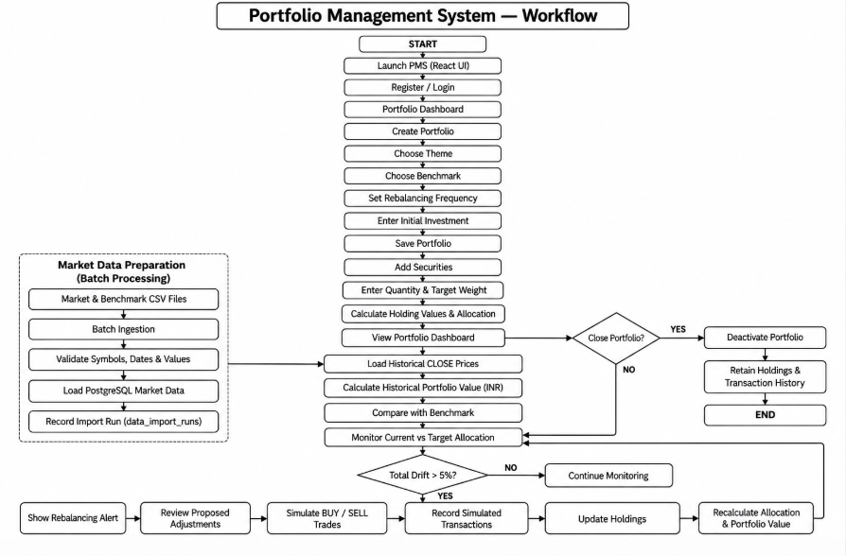
03

Slide 5
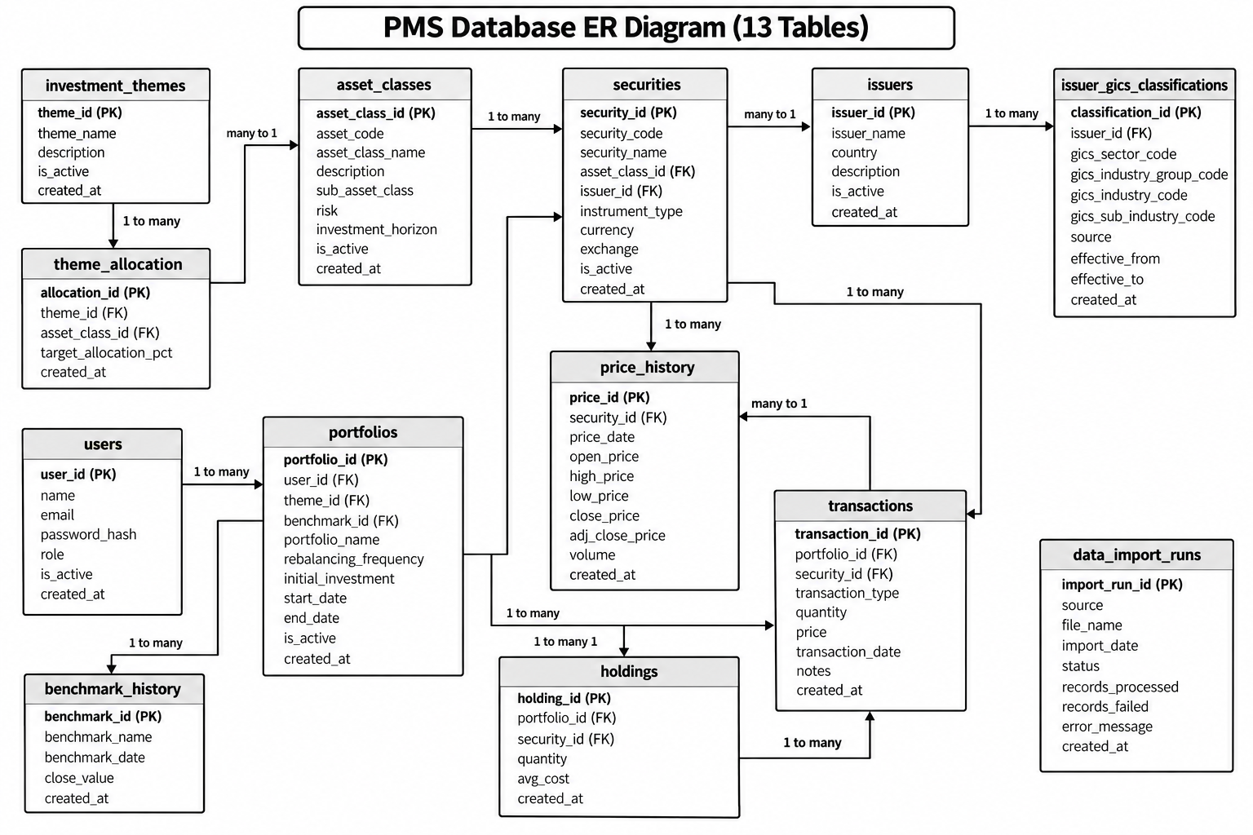
04

Slide 6
THANK YOU
05

